Slide 1
Cryogenic Equipment
J. G. Weisend II
www.europeanspallationsource.se
Winter 2025

Slide 2
Goals
Describe the nature, performance and design considerations of various components found in cryogenics
  Connections
    Bayonets
    Flanges
  Valves

Slide 3
Bayonets
Demountable piping joints that allow quick connections of cryogenic lines
Very useful in connecting to replaceable cryogenic liquid supplies. Frequently used in “U-Tubes”
Reentrant, low heat leak design
Uses at least one 300 K gas seal and sometimes a cryogenic liquid seal (typically Teflon)
Must be built to tight mechanical tolerances
Receiving end must be lower or at least horizontal to delivery end to avoid convection

Slide 4
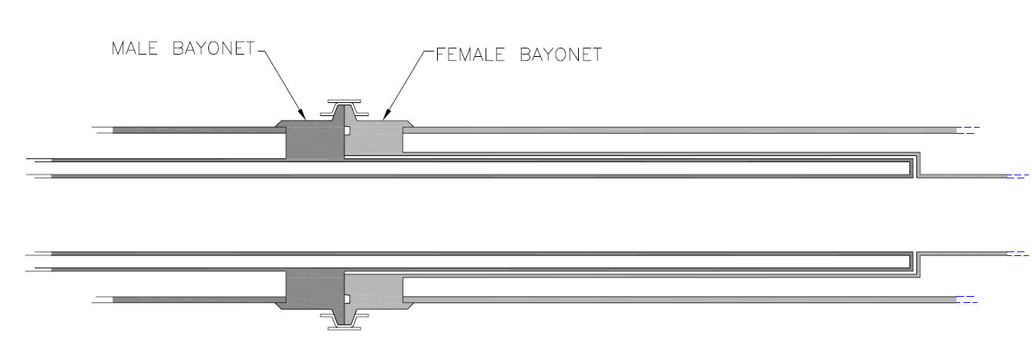
PBA Series Bayonet from
PHPK Technologies
Note:
No liquid seal
Very tight tolerances between
male & female sides to minimize convection
Long, thin walls connect 300 K and 4.2 K

Slide 5
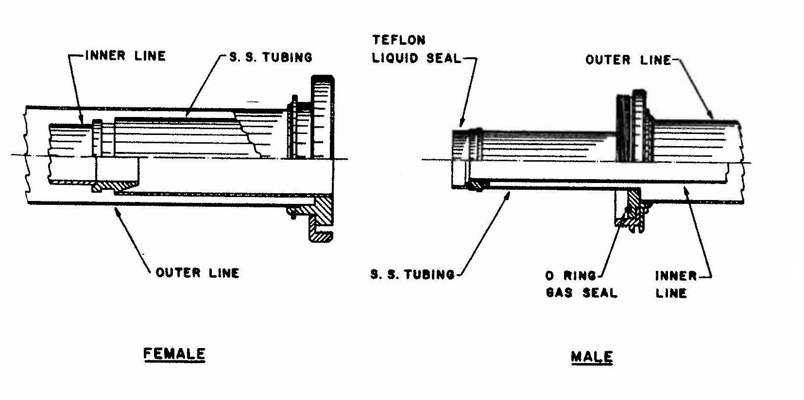
Air Force Style Hydrogen Bayonet from “Cryogenic Equipment” – D. Daney Handbook of Cryogenic Engineering

Slide 6
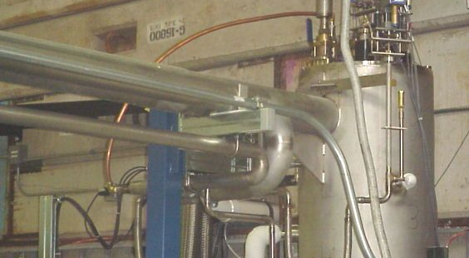
FNAL/SMTF Bayonet Can

Slide 7
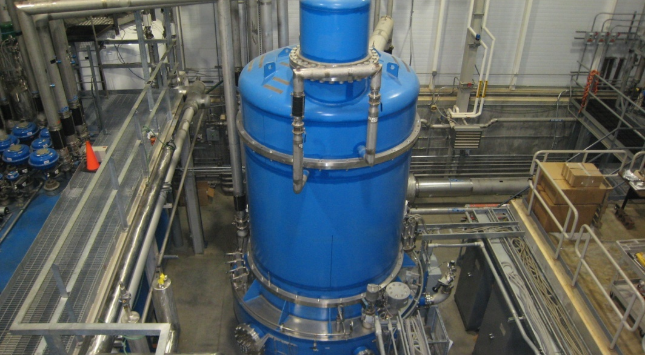
SNS Refrigeration Plant showing U-tubes

Slide 8
Flange Connections
How else do we connect pipes at cryogenic temperatures?
  Welding is almost always the most reliable approach but sometimes a demountable joint is required.
There are a number of demountable flange options
  Anything involving a polymer or rubber O-ring will clearly not work at cryogenic temperatures
  Sealing options include
    Flanges using a soft metal gasket ( typically copper) such as Conflat flanges
    Flanges using a metal “c” ring
    Flanges using an indium o-ring – best used in test scenarios and typically home-made
  With proper design and installation all of these approaches can provide leak tight joints down even at superfluid helium temperatures (< 2.2 K)
Note that vacuum and liquid leaks are a major source of problems in cryogenics. Carefully thought out and reliable connections are a key to success

Slide 9
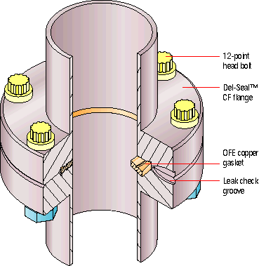
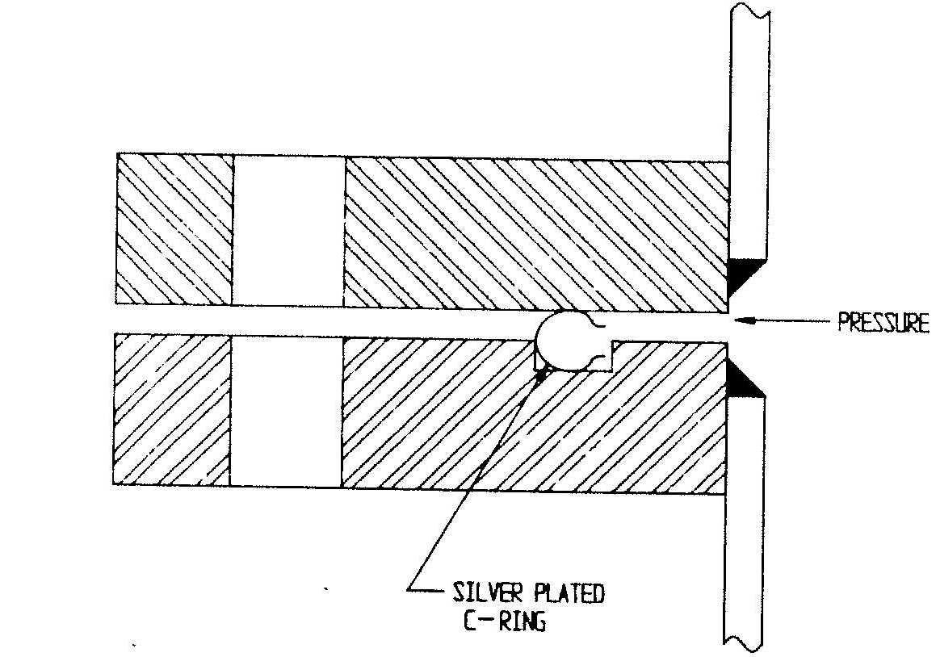
Examples of Flanged Connections for Cryogenic Use
(both are commercially available)
ConFlat Style
Soft Metal Gasket
C Ring Style

Slide 10
Example of Indium O-Ring Seal
From G. McIntosh in
The Handbook of Cryogenic Engineering

Slide 11
Use of Invar Washers
If upon cool down the flange material shrinks more than the bolt material then the seal may open up and leak
One way to prevent this is to use invar washers so that the seal actually tightens during cool down
The goal here is to size the components such that the bolt shrinks more than the combination of the 2 flanges and the invar washer

Slide 12
Valves
Valves are an important part of cryogenic systems
Valves direct flows and control both flow rates and pressure drops
Cryogenic valves have to operate at cryogenic temperatures and minimize the heat leak from room temperature
Except in very specialized cases, cryogenic valves have room temperature actuators
Valves can be manually operated or more commonly operated via a control system. The actuators for remote operation are typically electro pneumatic – a current or voltage signal from the control system regulates the pressure on the pneumatic drive that controls the valve position.
A wide range of cryogenic valves is available in industry

Slide 13
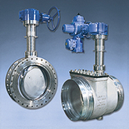

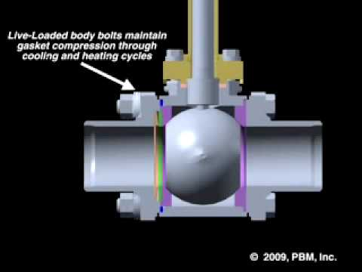

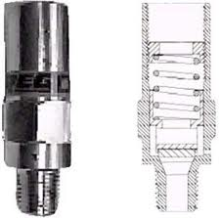
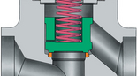
Basic Valve Types
(All can be implemented in cryogenic systems with proper design and materials)
Ball
Butterfly
Relief
Globe
Check
Gate

Slide 14
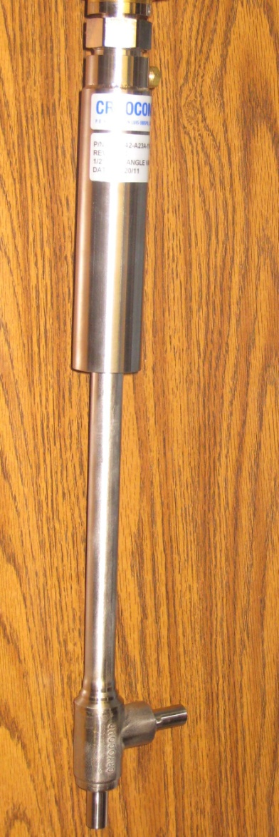
Examples of Cryogenic Valves
CVI
Model 2060
Contains
vacuum jacket
Heat Leak reduced
via thin walled tubes
1 inch valve has a
measured heat leak of
1.3 W to 4.2 K
JT Valve
Cryocomp
½ inch IPS
Designed to be installed inside cryostats
Heat Leak to 4.2 K is ~ 1 W

Slide 15
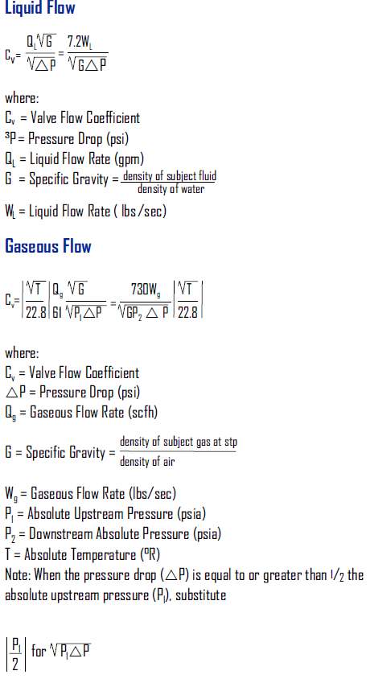
Sizing of Valves
Valves are typically sized using the parameter C_{v}
  This parameter is defined as the number of Gal/min of water that passes through the valve with a pressure drop of 1 psi
  This can be related to properties we care about in cryogenics by
  Be sure to use appropriate properties
  Note ºR = (9/5)K
From Acme
Cryogenics
Catalog

